Slide 1
The Channel Allocation Problem
Static Channel Allocation in LANs and MANs
Dynamic Channel Allocation in LANs and MANs
Data Link Layer

Slide 2
Static Channel Allocation
Mean time delay, T = 1/(μC – λ)
Where, λ is arrival rate i.e. frame/second
and μC is service rate i.e. frame /second
C is capacity of data rate, 1/μ is bits per frame
or 1/μ is mean frame length
T(FDM) = N T, if single channel is divided into N subchannels(put C->C/N and λ ->λ/N
T(TDM)= NT, each user is statically allocated every Nth slot.
Data Link Layer

Slide 3
MAC Protocols: a taxonomy
Three broad classes:
Channel Partitioning
  divide channel into smaller “pieces” (time slots, frequency, code)
  allocate piece to node for exclusive use
Random Access
  channel not divided, allow collisions
  “recover” from collisions
“Taking turns”
  Nodes take turns, but nodes with more to send can take longer turns
Data Link Layer
5-<number>

Slide 4

Channel Partitioning MAC protocols: TDMA
TDMA: time division multiple access
access to channel in "rounds"
each station gets fixed length slot (length = pkt trans time) in each round
unused slots go idle
example: 6-station LAN, 1,3,4 have pkt, slots 2,5,6 idle
TDM (Time Division Multiplexing): channel divided into N time slots, one per user; inefficient with low duty cycle users and at light load.
FDM (Frequency Division Multiplexing): frequency subdivided.
Data Link Layer
5-<number>

Slide 5
Channel Partitioning MAC protocols: FDMA
FDMA: frequency division multiple access
channel spectrum divided into frequency bands
each station assigned fixed frequency band
unused transmission time in frequency bands go idle
example: 6-station LAN, 1,3,4 have pkt, frequency bands 2,5,6 idle
TDM (Time Division Multiplexing): channel divided into N time slots, one per user; inefficient with low duty cycle users and at light load.
FDM (Frequency Division Multiplexing): frequency subdivided.
time
frequency bands
Data Link Layer
5-<number>

Slide 6
Random Access Protocols
When node has packet to send
  transmit at full channel data rate R.
  no a priori coordination among nodes
two or more transmitting nodes ➜ “collision”,
random access MAC protocol specifies:
  how to detect collisions
  how to recover from collisions (e.g., via delayed retransmissions)
Examples of random access MAC protocols:
  slotted ALOHA
  ALOHA
  CSMA, CSMA/CD, CSMA/CA
Data Link Layer
5-<number>

Slide 7
Slotted ALOHA
Assumptions
all frames same size
time is divided into equal size slots, time to transmit 1 frame
nodes start to transmit frames only at beginning of slots
nodes are synchronized
if 2 or more nodes transmit in slot, all nodes detect collision
Operation
when node obtains fresh frame, it transmits in next slot
no collision, node can send new frame in next slot
if collision, node retransmits frame in each subsequent slot with prob. p until success
Data Link Layer
5-<number>

Slide 8

Slotted ALOHA
Pros
single active node can continuously transmit at full rate of channel
highly decentralized: only slots in nodes need to be in sync
simple
Cons
collisions, wasting slots
idle slots
nodes may be able to detect collision in less than time to transmit packet
clock synchronization
Data Link Layer
5-<number>

Slide 9
Slotted Aloha efficiency
Efficiency is the long-run
fraction of successful slots
when there are many nodes, each with many frames to send
For max efficiency with N nodes, find p* that maximizes
Np(1-p)^{N-1}
For many nodes, take limit of Np*(1-p*)^{N-1} as N goes to infinity, gives 1/e = .37
Suppose N nodes with many frames to send, each transmits in slot with probability p
prob that node 1 has success in a slot = p(1-p)^{N-1}
prob that any node has a success = Np(1-p)^{N-1}
At best: channel
used for useful
transmissions 37%
of time!
Data Link Layer
5-<number>

Slide 10

Pure (unslotted) ALOHA
unslotted Aloha: simpler, no synchronization
when frame first arrives
  transmit immediately
collision probability increases:
  frame sent at t₀ collides with other frames sent in [t₀-1,t₀+1]
Data Link Layer
5-<number>

Slide 11
Pure Aloha efficiency
P(success by given node) = P(node transmits) .
P(no other node transmits in [t₀-1,t₀] .
P(no other node transmits in [t₀, t₀+1]
= p . (1-p)^{N-1 .} (1-p)^{N-1}
= p . (1-p)^{2(N-1)}
… choosing optimum p and then letting n -> infty ...
^{= 1/(2e) = .18}
Even worse !
Data Link Layer
5-<number>

Slide 12
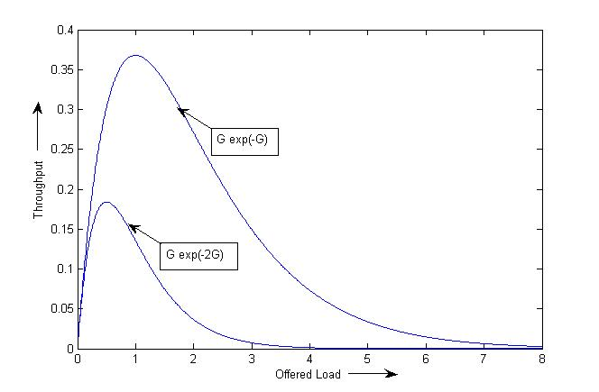
Throughput Comparison
Data Link Layer

Slide 13
Carrier Sense Multiple Access
To minimize the no. of collision or maximize the performance, we can use the concept of sensing the medium
It is based on the technique listen before talk
or sense before transmit
But it can not eliminate all the collision
It is able to reduce the collision and improve the throughput
Data Link Layer

Slide 14
CSMA (Carrier Sense Multiple Access)
CSMA: listen before transmit:
If channel sensed idle: transmit entire frame
If channel sensed busy, defer transmission
Human analogy: don’t interrupt others!
Data Link Layer
5-<number>

Slide 15
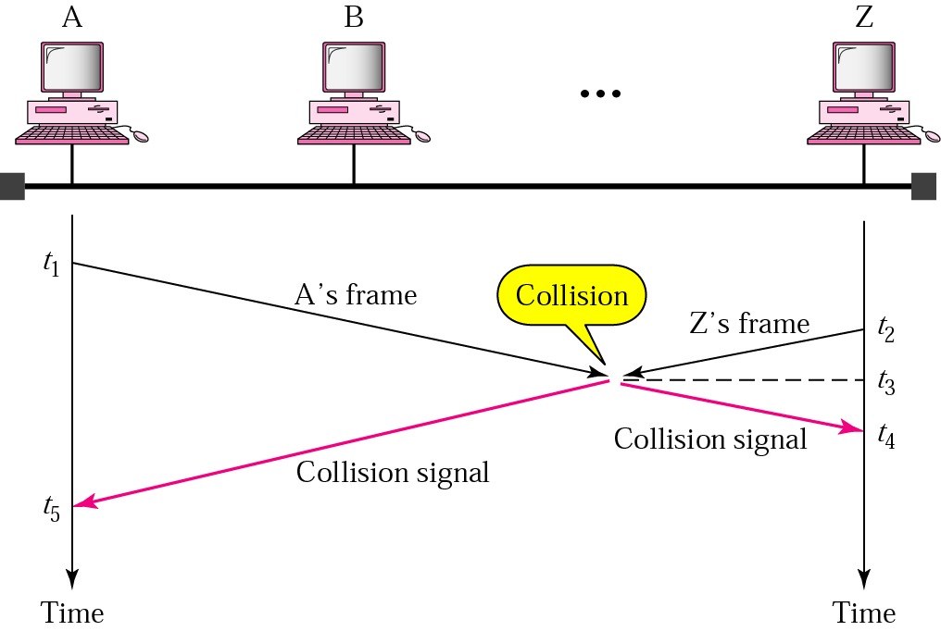
Collision in CSMA
Data Link Layer

Slide 16
Persistence Technique
This is technique defined that what should we do when medium is busy
Non-persistence:
1. If the medium is idle ,transmit; otherwise ,
go to step 2
2. If the medium is busy , wait an amount of
time drawn from a probability
distribution(retransmission delay) and
repeat step 1
Data Link Layer

Slide 17
1-Persistence
Algorithm:
1. If the medium is idle ,transmit; otherwise ,
go to step 2
2. If the medium is busy , continue to listen until
the channel is sensed idle; then transmit
immediately
Still, there is a chance of collision, when two stations senses the medium simultaneously
Data Link Layer

Slide 18
p-Persistence
Algorithm:
1. If the medium is idle ,transmit with probability p, and delay one time unit with probability (1-p) (The time unit is typically equal to the maximum propagation delay)
2. If the medium is busy, continue to listen until the channel is idle and repeat step 1
3. If the transmission is delayed one time unit, repeat step 1
It shows the highest performance among the all persistence technique
Data Link Layer

Slide 19
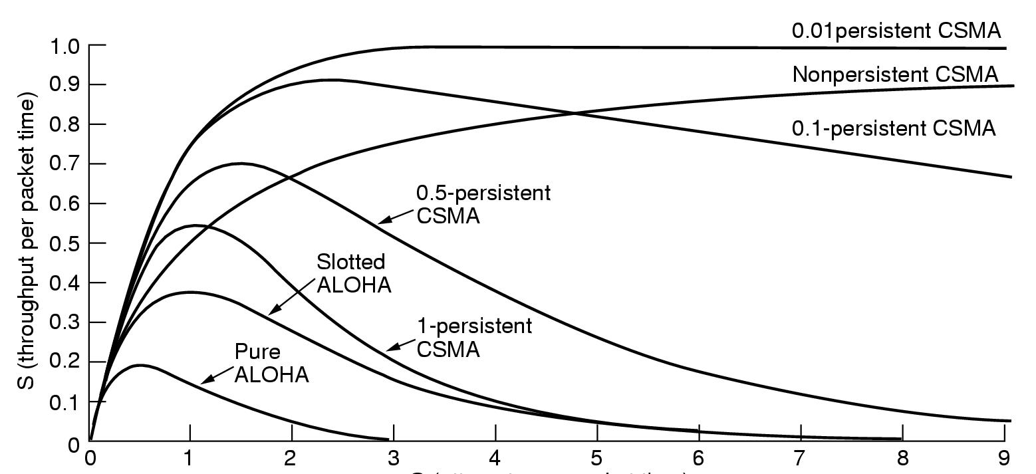
Throughput Comparison
Data Link Layer

Slide 20
“Taking Turns” MAC protocols
channel partitioning MAC protocols:
  share channel efficiently and fairly at high load
  inefficient at low load: delay in channel access, 1/N bandwidth allocated even if only 1 active node!
Random access MAC protocols
  efficient at low load: single node can fully utilize channel
  high load: collision overhead
“taking turns” protocols
  look for best of both worlds!
Data Link Layer
5-<number>

Slide 21
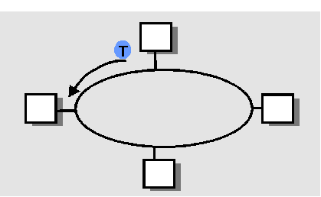
“Taking Turns” MAC protocols (Controlled Access)
Polling:
master node “invites” slave nodes to transmit in turn
concerns:
  polling overhead
  latency
  single point of failure (master)
Token passing:
control token passed from one node to next sequentially.
token message
concerns:
  token overhead
  latency
  single point of failure (token)
Data Link Layer
5-<number>

Slide 22
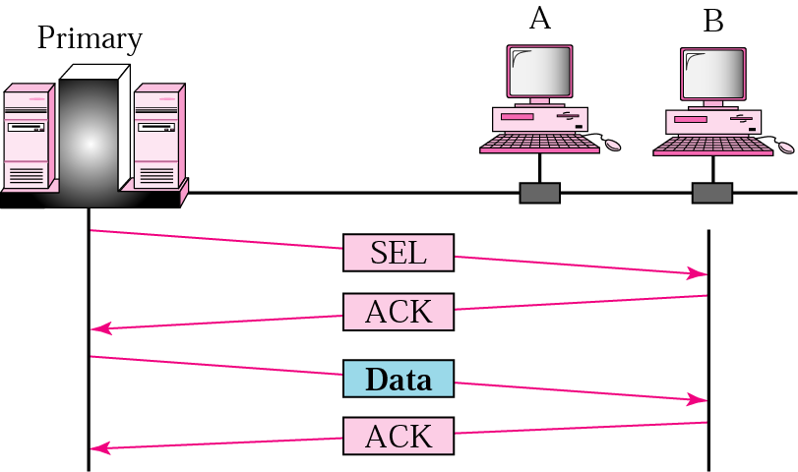
Select
Data Link Layer

Slide 23
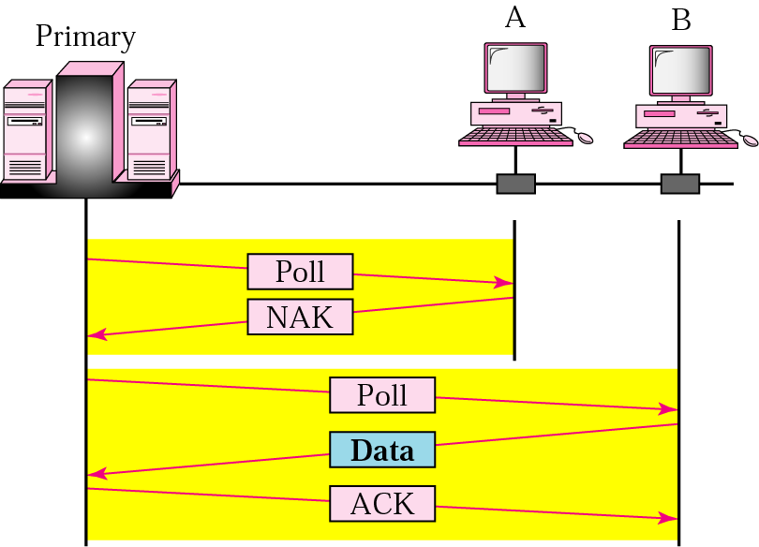
Poll
Data Link Layer

Slide 24
Token Passing
A token circulates around the ring, if no data are being sent
The station captures the token and sends one or more frames
It will keep capture till they have frame or allocated time has not expired
Finally release the token after used
Data Link Layer

Slide 25
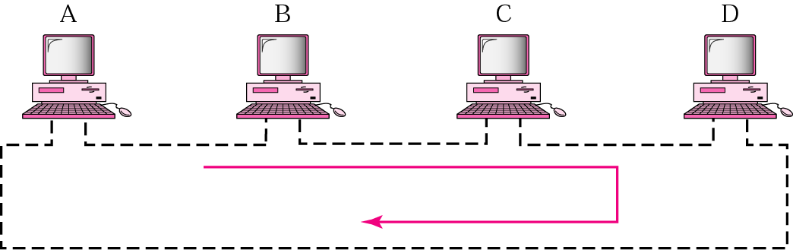
Figure 13.12 Token-passing network
Data Link Layer

Slide 26
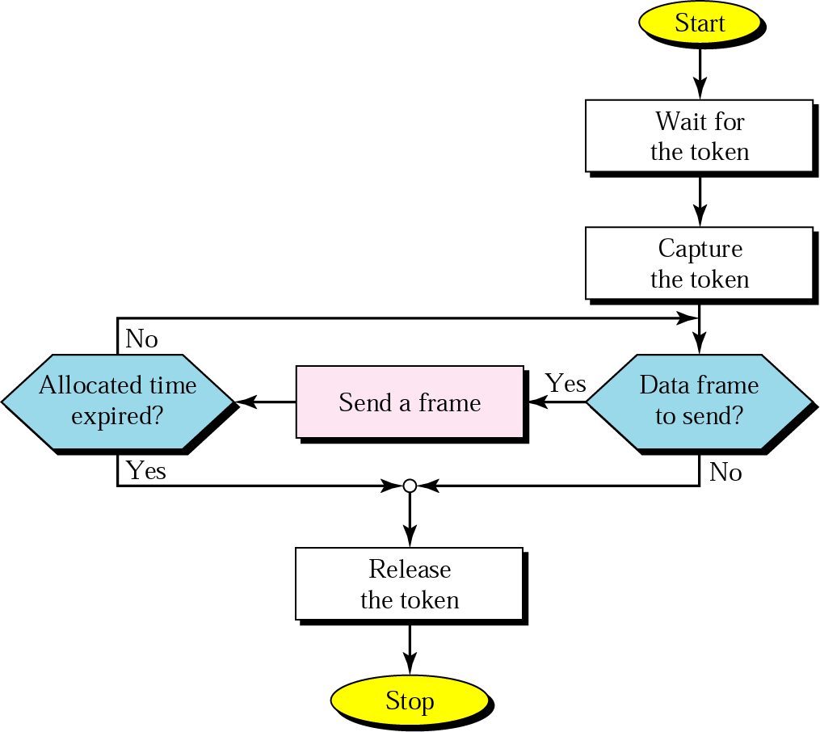
Token-passing procedure
Data Link Layer

Slide 27
Link Layer
5.1 Introduction and services
5.2 Error detection and correction
5.3Multiple access protocols
5.4 Link-Layer Addressing
5.5 Ethernet
5.6 Hubs and switches
5.7 PPP
Data Link Layer
5-<number>

Slide 28

Ethernet
“dominant” wired LAN technology:
cheap $20 for 100Mbs!
first widely used LAN technology
Simpler, cheaper than token LANs and ATM
Kept up with speed rate: 10 Mbps – 10 Gbps
Metcalfe’s Ethernet
sketch
Data Link Layer
5-<number>

Slide 29

Ethernet Frame Structure
Sending adapter encapsulates IP datagram (or other network layer protocol packet) in Ethernet frame
Preamble:
7 bytes with pattern 10101010 followed by one byte with pattern 10101011
used to synchronize receiver, sender clock rates
Data Link Layer
5-<number>

Slide 30
Ethernet Frame Structure (more)
Addresses: 6 bytes
  if adapter receives frame with matching destination address, or with broadcast address (eg ARP packet), it passes data in frame to net-layer protocol
  otherwise, adapter discards frame
Type: indicates the higher layer protocol (mostly IP but others may be supported such as Novell IPX and AppleTalk)
CRC: checked at receiver, if error is detected, the frame is simply dropped
Data Link Layer
5-<number>

Slide 31
Ethernet uses CSMA/CD
No slots
adapter doesn’t transmit if it senses that some other adapter is transmitting, that is, carrier sense
transmitting adapter aborts when it senses that another adapter is transmitting, that is, collision detection
Before attempting a retransmission, adapter waits a random time, that is, random access
Data Link Layer
5-<number>

Slide 32
Ethernet CSMA/CD algorithm
1. Adaptor receives datagram from net layer & creates frame
2. If adapter senses channel idle, it starts to transmit frame. If it senses channel busy, waits until channel idle and then transmits
3. If adapter transmits entire frame without detecting another transmission, the adapter is done with frame !
4. If adapter detects another transmission while transmitting, aborts and sends jam signal
5. After aborting, adapter enters exponential backoff: after the mth collision, adapter chooses a K at random from
{0,1,2,…,2^{m}-1}. Adapter waits K·512 bit times and returns to Step 2
Data Link Layer
5-<number>

Slide 33
Truncated Binary Exponential Backoff
  Attempts := 0;
  Attempt Limit is 16 and Backoff Limit 10.
  While
  { (Frame NOT Transmitted Successfully)
  AND (Attempts < Attempt Limit) }
  K : = Min (Attempts, Backoff Limit)
  R : = Random (0, 2^{k}-1)
  delay : = R * SlotTime;
  Wait (delay)
  Increment Attempts;
  End While
  This algorithm yields a "statistical fairness" in the sharing of bandwidth.
Data Link Layer

Slide 34
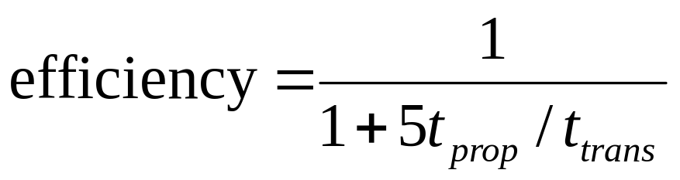
CSMA/CD efficiency
T_{prop} = max prop between 2 nodes in LAN
t_{trans} = time to transmit max-size frame
Efficiency goes to 1 as t_{prop} goes to 0
Goes to 1 as t_{trans} goes to infinity
Much better than ALOHA, but still decentralized, simple, and cheap
Data Link Layer
5-<number>

Slide 35
Link Layer
5.1 Introduction and services
5.2 Error detection and correction
5.3Multiple access protocols
5.4 Link-Layer Addressing
5.5 Ethernet
5.6 Hubs and switches
5.7 PPP
5.8 Bridges, switches, gateway
Data Link Layer
5-<number>

Slide 36
Repeater
Repeater, Hub, Bridge & Switch
A repeater receives a signal, regenerates it, and passes it on.
It can regenerate and retime network signals at the bit level to allow them to travel a longer distance on the media.
It operates at Physical Layer of OSI
The Four Repeater Rule for 10-Mbps Ethernet should be used as a standard when extending LAN segments.
This rule states that no more than four repeaters can be used between hosts on a LAN.
This rule is used to limit latency added to frame travel by each repeater.
Data Link Layer

Slide 37
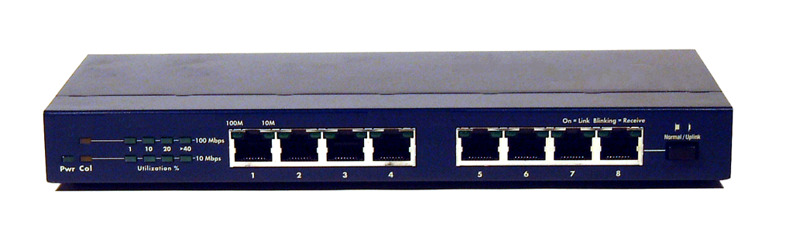
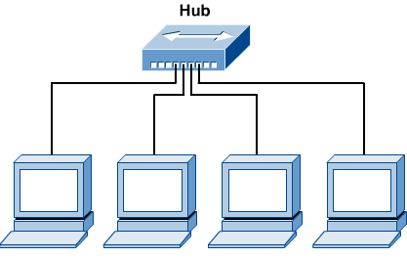
Hub
Repeater, Hub, Bridge & Switch
Hubs are used to connect multiple nodes to a single physical device, which connects to the network.
Hubs are actually multiport repeaters.
Using a hub changes the network topology from a linear bus, to a star.
With hubs, data arriving over the cables to a hub port is electrically repeated on all the other ports connected to the same network segment, except for the port on which the data was sent.
Data Link Layer

Slide 38
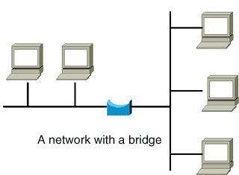
Bridge
Repeater, Hub, Bridge & Switch
Bridges are used to logically separate network segments within the same network.
They operate at the OSI data link layer (Layer 2) and are independent of higher-layer protocols.
The function of the bridge is to make intelligent decisions about whether or not to pass signals on to the next segment of a network.
When a bridge receives a frame on the network, the destination MAC address is looked up in the bridge table to determine whether to filter, flood, or copy the frame onto another segment
Broadcast Packets are forwarded
Data Link Layer

Slide 39
Switch
Repeater, Hub, Bridge & Switch
Switches are Multiport Bridges.
Switches provide a unique network segment on each port, thereby separating collision domains.
Today, network designers are replacing hubs in their wiring closets with switches to increase their network performance and bandwidth while protecting their existing wiring investments.
Like bridges, switches learn certain information about the data packets that are received from various computers on the network.
Switches use this information to build forwarding tables to determine the destination of data being sent by one computer to another computer on the network.
Data Link Layer

Slide 40

Switches: Dedicated Access
Repeater, Hub, Bridge & Switch
Hosts have direct connection to switch
Full Duplex: No collisions
Switching: A-to-A’ and B-to-B’ simultaneously, no collisions
Switches can be cascaded to expand the network
A
C’
B
switch
C
B’
A’
Data Link Layer

Slide 41
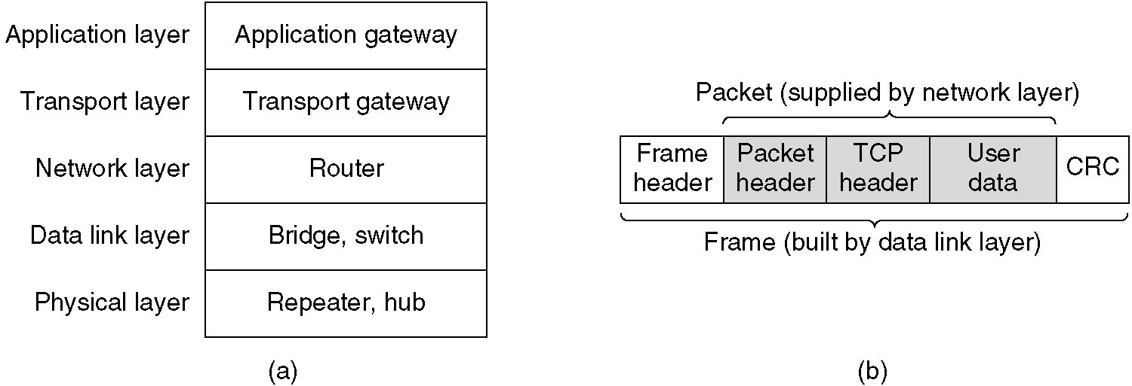
Repeaters, Hubs, Bridges, Switches, Routers and Gateways
(a) Which device is in which layer.
(b) Frames, packets, and headers.
Data Link Layer

Slide 42
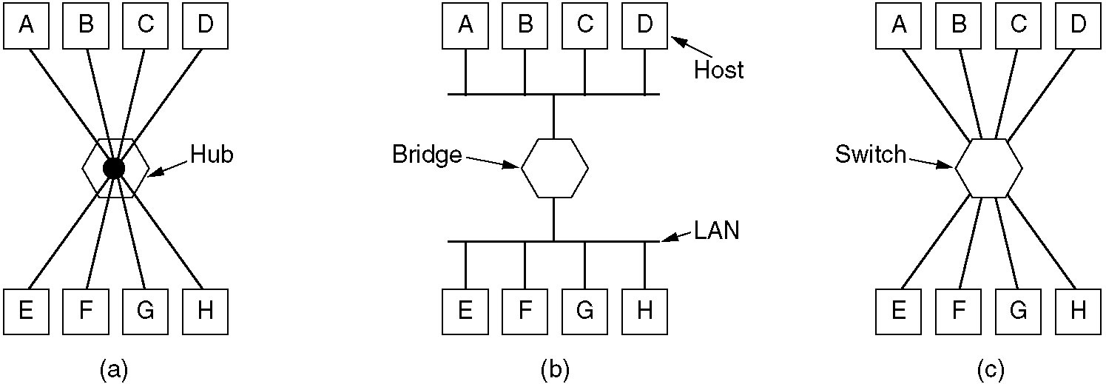
Repeaters, Hubs, Bridges, Switches, Routers and Gateways (2)
(a) A hub. (b) A bridge. (c) a switch.
Data Link Layer

Slide 43
Thank You
Data Link Layer

